Slide 1
Python Project
Matheus + Andre

Slide 2
Requirements
Basics
Code planning and execution to achieve an MVP
Enhancements
Extra features (up to 3)
Deployment of new libraries (at least 2)

Slide 3
Ideas
Game kickoff:
Play a theme music
Library used: IPython.display - Audio
Add feature to Game Room:
Locked piano requiring note sequence to unlock
Simple if sequence used
Add feature in Bedroom 2:
Locked dresser requiring numerical sequence to unlock
Sequence is retrieved via a new object - paper - available in the Living room (dining table)
Library used: random

Slide 4
Our difficulties
We didn’t give a target to our new object (paper), which caused the game to crash.
Solved below:
paper = {
"name": "a paper with the code: " + password,
"type": "paper_code",
"target": dresser,
}
It was a challenge to include a music file and make our code run at the same time

Slide 5
Future Improvements
Learn how to run formulas alongside the music file to:
Raise the volume as the game progresses;
Merge different sounds;
Stop the game once the music finishes;
Run music files in Spyder without using the notebook plugin - source new libraries.

Slide 6
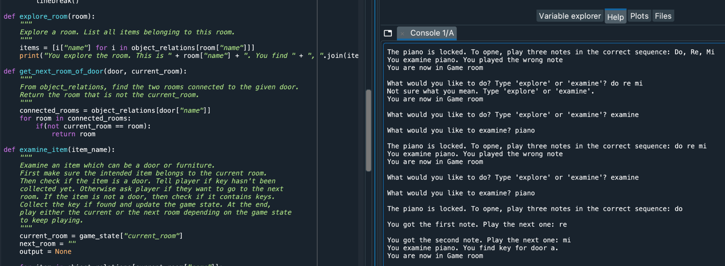
Demo

